Slide 1


QuChaTeR: A Hybrid Quantum-Chaotic Temporal Framework for Earthquake Prediction
Emir Kaan Özdemir - İstanbul Erkek High School
Ministry of National Education

Slide 2
Introduction
Signal processing is required to try to forecast earthquakes, and this is mostly done with classical algorithms and computers.
This study examines a framework that makes earthquake predictions using a hybrid algorithm (combination of quantum and classical algorithms).

Slide 3
Motivation
Earthquake signals are nonlinear, chaotic, and non-stationary.
Classical models fail to capture complex temporal dynamics.
Can chaos theory + quantum computing improve prediction?

Slide 4
Related Works
Chaos-based modeling: Yi et al. (2010) → Captures nonlinear/chaotic patterns in seismic time series
Wavelet-based methods: Yamamoto & Baker → Multi-scale temporal feature extraction
Deep learning models: Hamdi et al. (2024) → Bi-LSTM outperforms LSTM (long-term dependencies) Sneka & Kanchana (2025) → CNN–LSTM improves geolocation-based forecasting
Quantum-inspired models: Dutta et al. (2025) → Hybrid quantum neural networks for tsunami prediction
[1] Yi et al., ICISS, 2010 [4] Sneka & Kanchana, JAICN, 2025
[2] Yamamoto & Baker, BSSA, 2013 [5] Dutta et al., EPJ QT, 2025
[3] Hamdi et al., IJECBE, 2024

Slide 5
Dataset & Preprocessing
Dataset: Northern California Earthquake Data Center — 512-hour seismic time-series used for binary earthquake prediction.
Preprocessing
Class imbalance handled using SMOTE.
Signals normalized and missing values imputed.
Wavelet Transform (DWT) applied for noise reduction and multi-scale feature extraction.
[6] https://www.timeseriesclassification.com/description.php?Dataset=Earthquakes

Slide 6
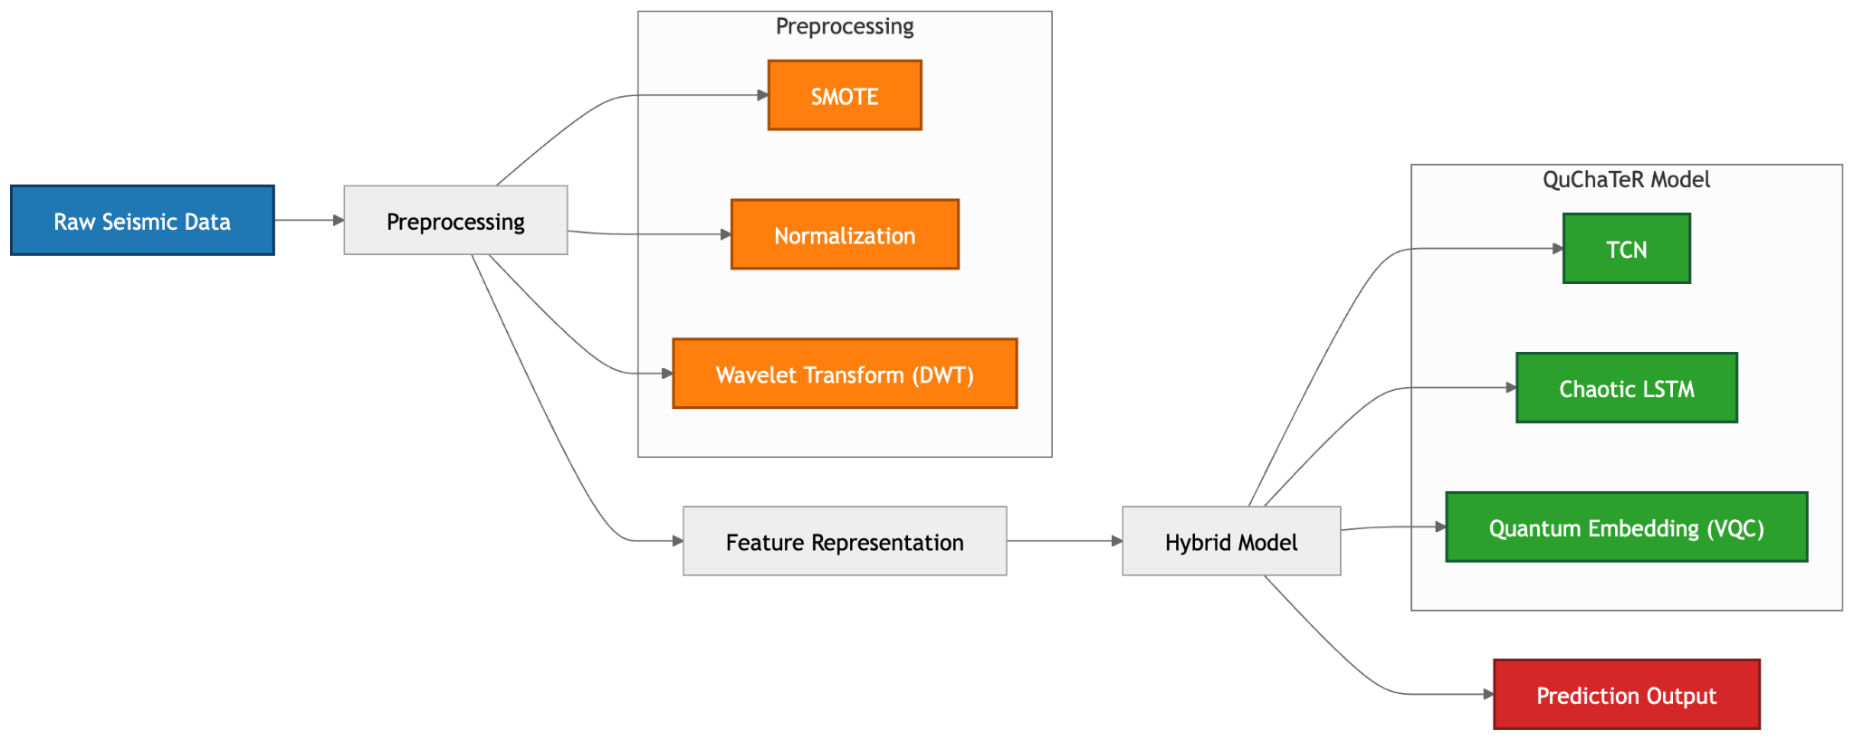
QuChaTeR Architecture Overview

Slide 7
QuChaTeR in One Equation

Slide 8
The Chaotic Engine: Nonlinear Perturbation
Chaotic Injection
Logistic Map perturbation:
Hénon Map dynamics:
Parameters
(Bounded chaotic regime)
(Bayesian optimization result)
[7] May, Nature, 1976
[8] Hénon, CMP, 1976

Slide 9



Quantum Embedding Layer
Configuration
6-qubit variational circuit
Rotation gates + entanglement (CNOT)

Slide 10
Experimental Setup
Models Compared
RNN, LSTM, GRU, 1D-CNN
Reservoir Computing
Quantum LSTM
Training Setup
50 epochs, Adam optimizer (lr = 0.001)
Same conditions for all models (fair comparison)
Train / validation / independent test split
NVIDIA L4 GPU
Quantum Setup
PennyLane simulator (noise-free)
6-qubit configuration selected
Evaluation Metrics
Accuracy, Precision, Recall, F1-score
Generalization Stability (G) metric

Slide 11
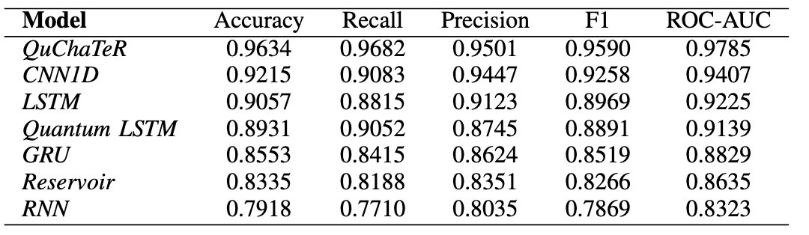
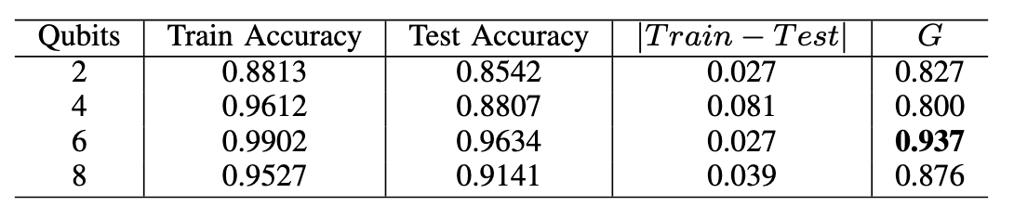
Results

Slide 12
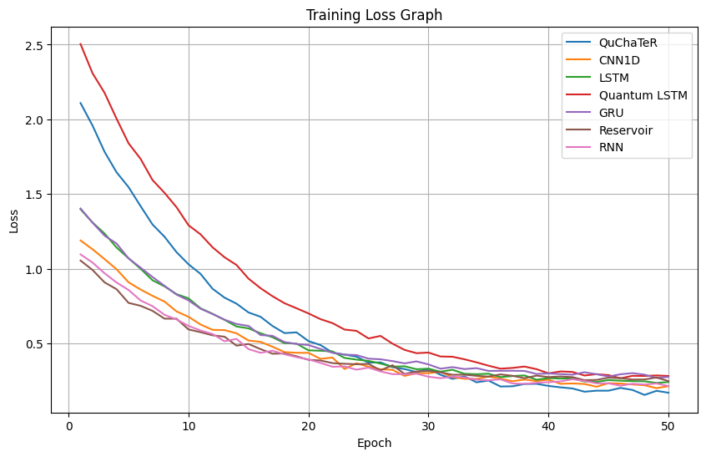
Results

Slide 13
Discussion
This study has shown that quantum-hybrid architectures are quite successful.
However, it should be noted that this study is not yet possible with current quantum computers. Therefore, it was carried out using simulators.

Slide 14
Future Work
Evaluation on real quantum hardware (NISQ devices)
Scaling to larger and more diverse seismic datasets
Exploration of deeper quantum circuits and architectures

Slide 15
Thank You for Your Attention
Emir Kaan Özdemir
Contact: emirkaanozdemir@gmail.com
Codes: https://github.com/emirkaanozdemr/QuChaTeR

Slide 16
Questions?

